Slide 1
King’s Gambit
Cory Petersen, Humza Syed, Youssef Ibrahim, Sedat Guvercin, Jason Nguyen, Jack Kellaher, Matthew Kelly

Slide 2
Table of Contents
Overview
Elements
Looking Ahead
Introduction
Flow Chart
Camera Element
Engine Element
Gantry Element
Demo
Goals for the Future

Slide 3
Introduction
Inspiration
Background
Chess is a growing field, requires two people
Multidisciplinary
Collaborative
Thought Process
End Goal
Three main elements
Challenges
Create a working prototype

Slide 4
System Flow Chart
Engine
Repeat
Reset and Wait for Opponent
Digital Board → Chess Move
Camera
Gantry
Physical Image → Digital Board
Chess Move → Move Piece
Notes:
After deciding what we wanted our final product to look like → the first thing we did is make a Project Flow Chart
This allowed us to outline the elements we needed in order to achieve our end goal
Our vision is for you to sit across from our robot, make an opening move, and let our product do the rest
Now, In order to play chess, the robot needs to see the chess board. Our camera element uses Computer Vision Software to translate a physical image of the chess board into a digital board, preserving all the positions in the process
That information is fed into the Engine element, which interfaces with the Stockfish API and calculates the next best move
That move is then given to the Gantry element, which uses a robotic arm to physically execute the chess engine’s recommendation
Finally, the gantry resets and this cycle repeats until one team has checkmated the other
Throughout this semester, we divided ourselves to construct each of these elements individually and achieve independent functionality. Later on, we’ll demonstrate that functionality and how we managed to integrate these components together, and Finally, we’ll discuss how we plan to further automate this project in the future.

Slide 5
01
The Camera
The Chess Robot’s Eyes. This is how we know what was played and store the pieces’ positions

Slide 6
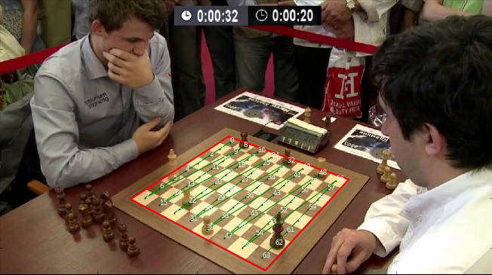
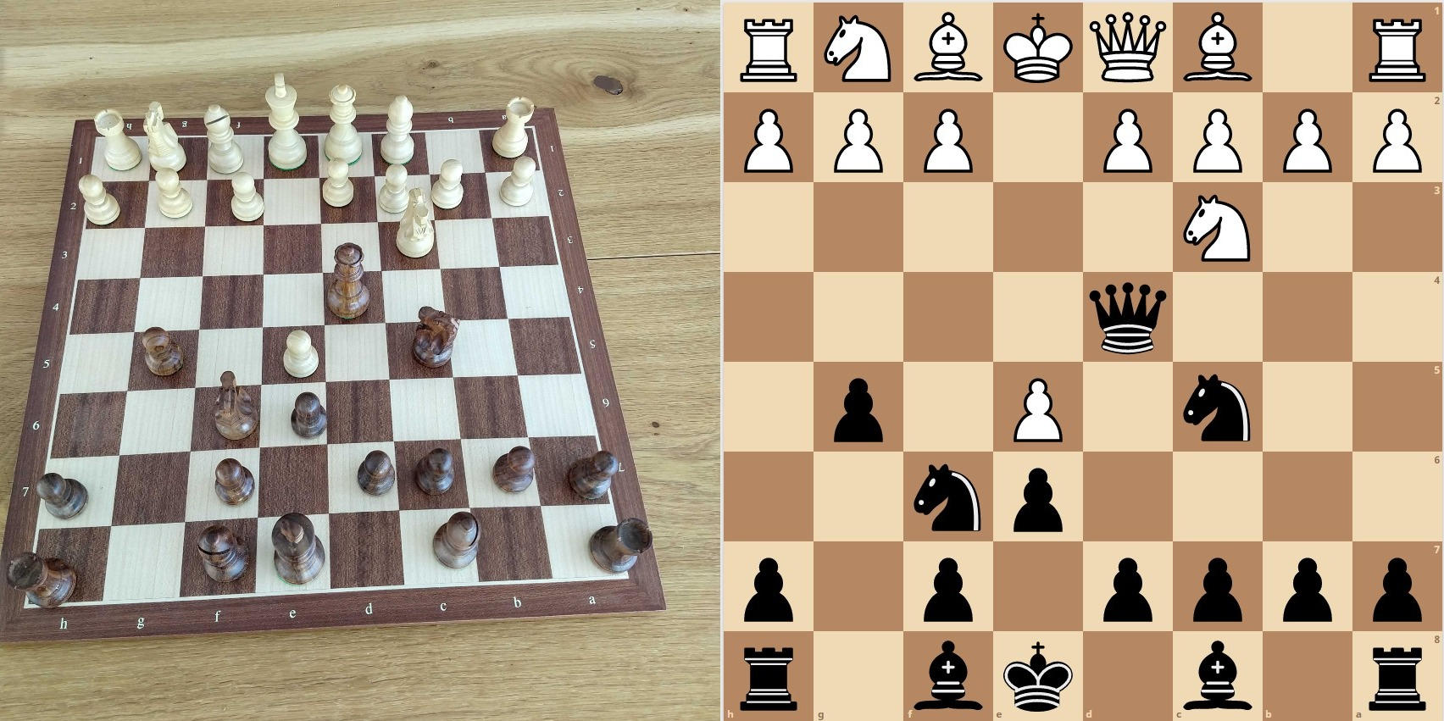
The Camera
STEP 01
STEP 02
STEP 03
STEP 04
PICTURE
RECOGNITION
TRANSLATION
SHARING
The first and easiest part is just taking a picture of the board
Using image processing we identify if there are pieces in certain squares
After detecting the positions of each piece, we generate a FEN notation
Once we have FEN notation we need to share it with the chess engine

Slide 7
02
The Engine
The Chess Robot’s Brain. Using the final image we can calculate the next move

Slide 8
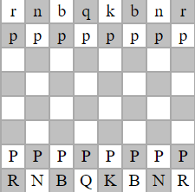
STOCKFISH API
ENGINE
DELTAS
Stockfish, the chess engine, evaluates the chess board and returns the next best move, depending on the set difficulty
In addition to FEN notation, analysis of the board generates “deltas.” Through Arduino, the gantry uses this to calculate where the arm needs to travel
Notes:
Each piece will have its own “bitboard,” a 64 bit binary value where each bit represents a square and a 0 and 1 represents whether that square is occupied respectively.
A chessboard will have 12 bitboards, one for each type of piece.
The white pawns (represented by the capital P) would have a bitboard represented by: 0000000000000000000000000000000000000000000000001111111100000000. 11 more bitboards would represent the rest of the pieces, which our camera would have to identify.

Slide 9
03
The Gantry
The Chess Robot’s Arms. This is how we translate what the robot thinks and sees to what it does
Notes:
This is the gantry, which is basically where we translate our software output into mechanical movements, specifically to move pieces

Slide 10
Gantry Components
Structure
Electronics
Actuation
The chassis fits around a 16” chess board and mitigates unwanted piece interference
Electronics for directing motor movement are housed and cable-routed along the assembly
Stepper motors and servo motors actuate the gantry in discrete steps to pick up and move pieces
Notes:
We designed the chassis, or the framework, to fit a 16 by 16 chessboard, which also reduces any error in potential piece interference
the electronics for the board that help actuate movement of the gantry are housed along the assembly
Such electronics, like the Stepper motors and servo motors perform the operations of the gantry in small steps that help move the pieces around easily

Slide 11
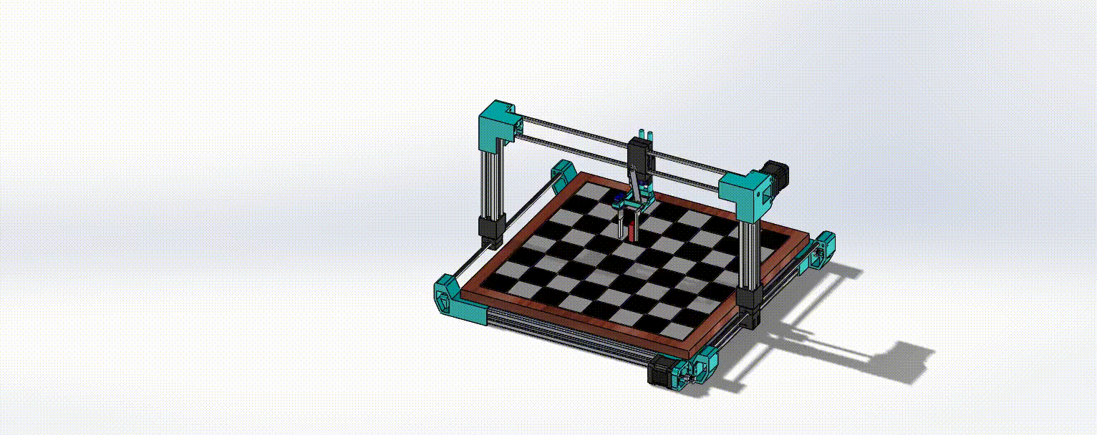
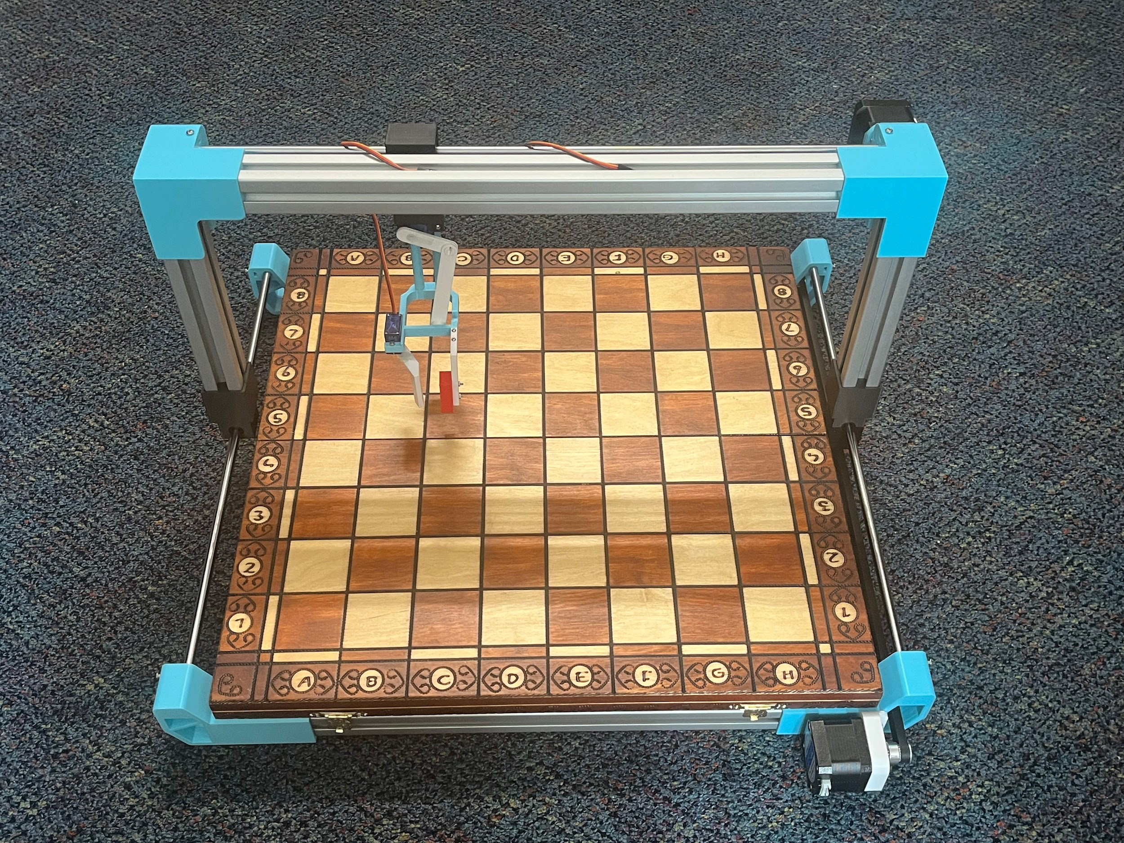
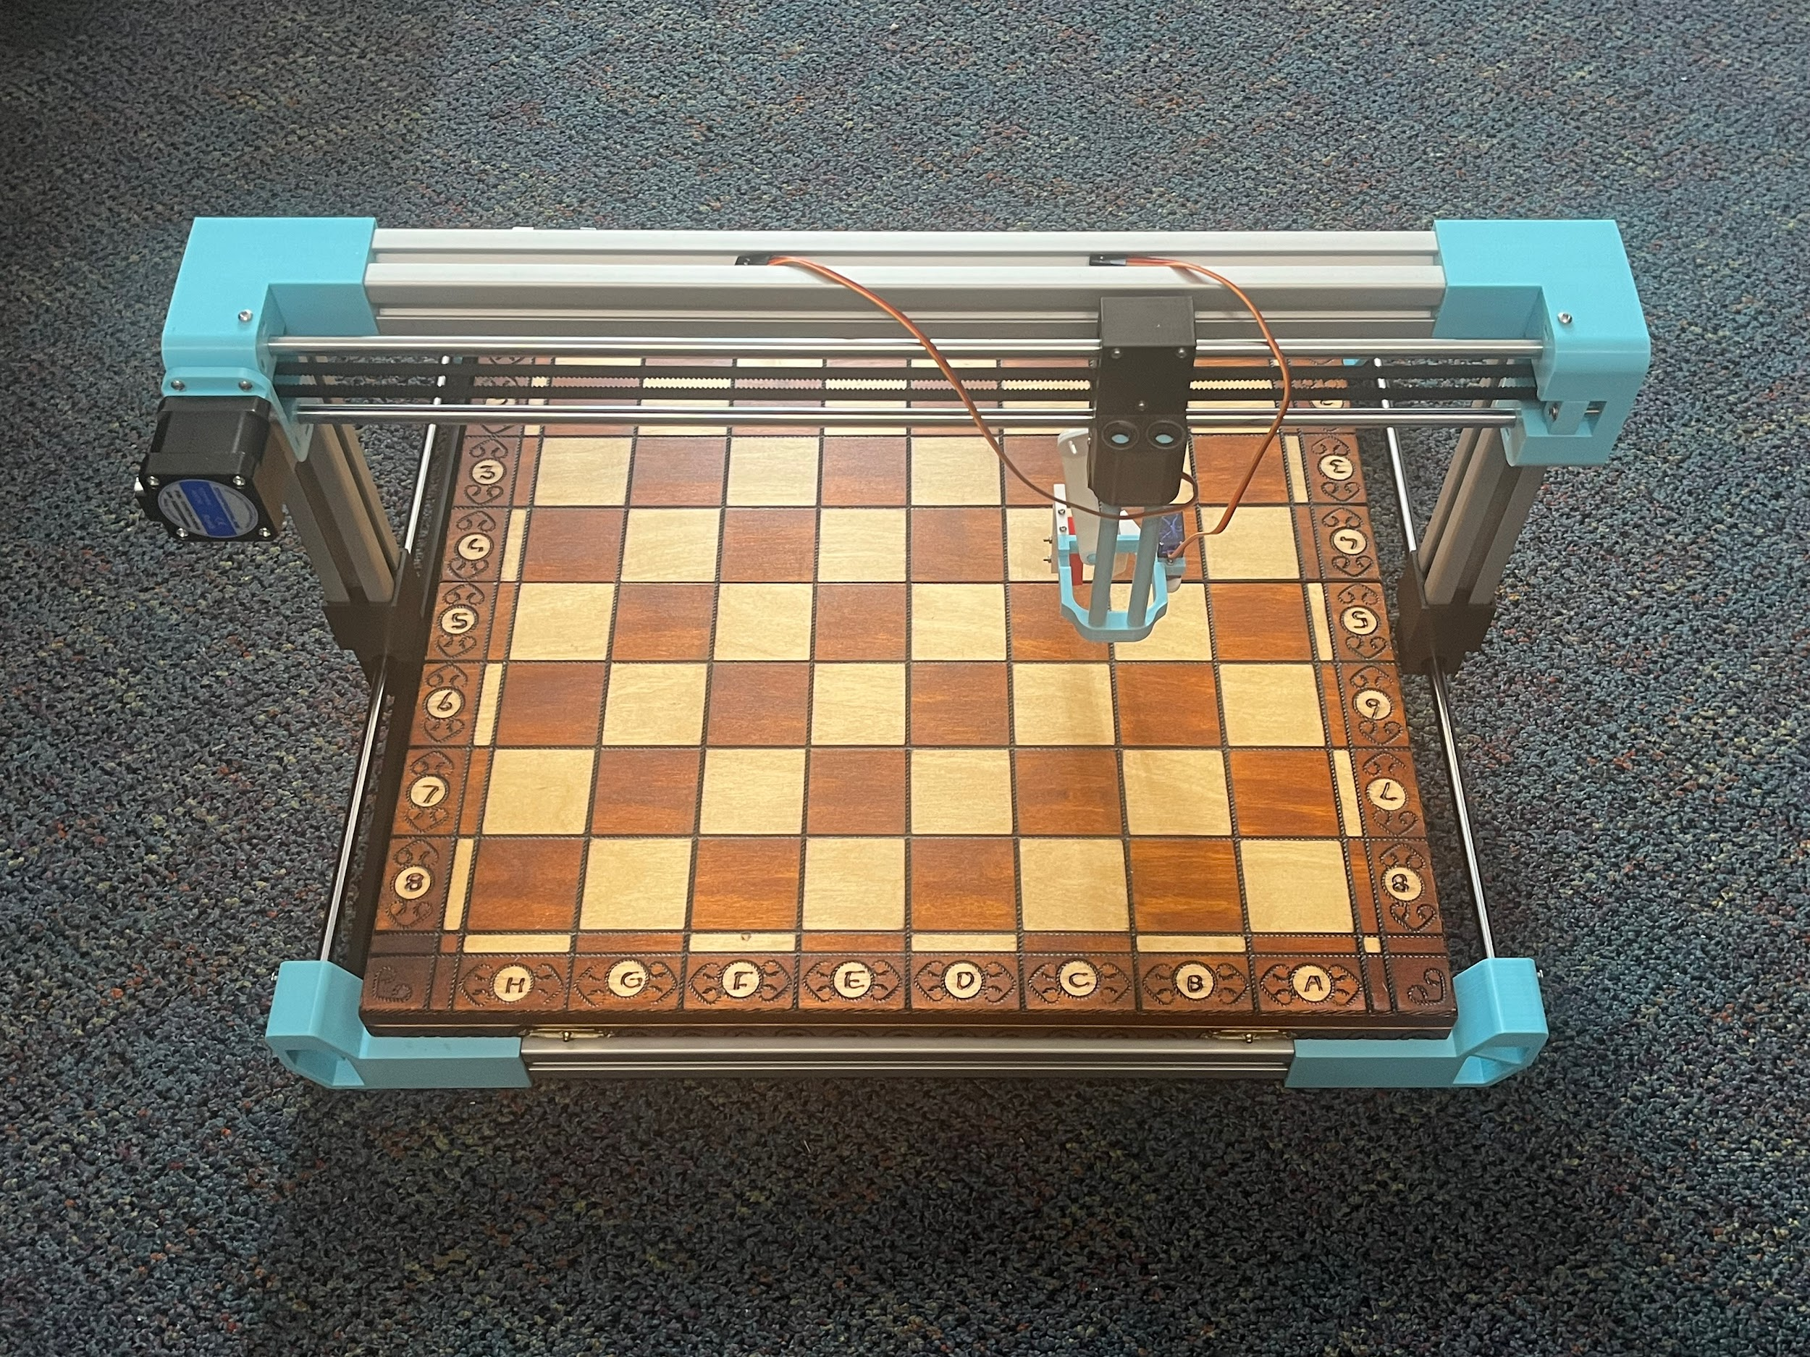
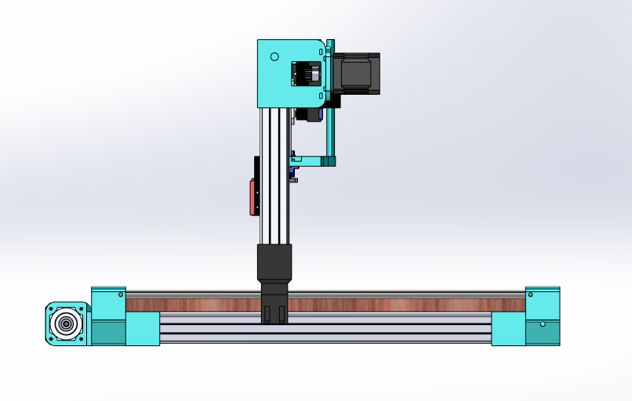
Design and Improvements
Notes:
Chose a design that is very similar to a CNC chassis that would be found on a 3d printer or machining equipment
Already plenty of research/existing designs
Reduced material cost
Toolhead saw many different designs, including scissor lift, claw machine and is now based on two servo motors
Toolhead moves laterally using nema 17 stepper motors. Vertical movement and grabbing is sg90 servo
Working on a design for electronics housing. Will likely be attached to the side of chassis
Each component needs space for wire routing, need length of wires to be equal or greater than the total diagonal distance over board

Slide 12
Demo

Slide 13
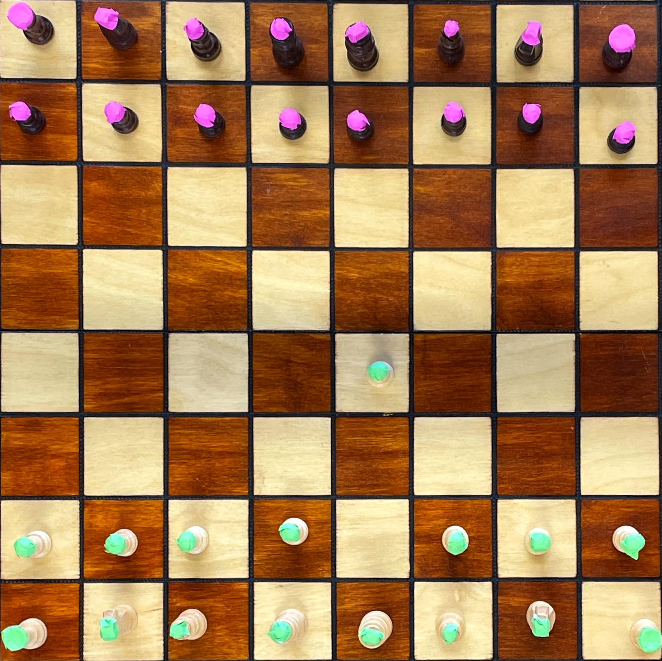
Takes Picture, Crops, and does Perspective Transform

Slide 14
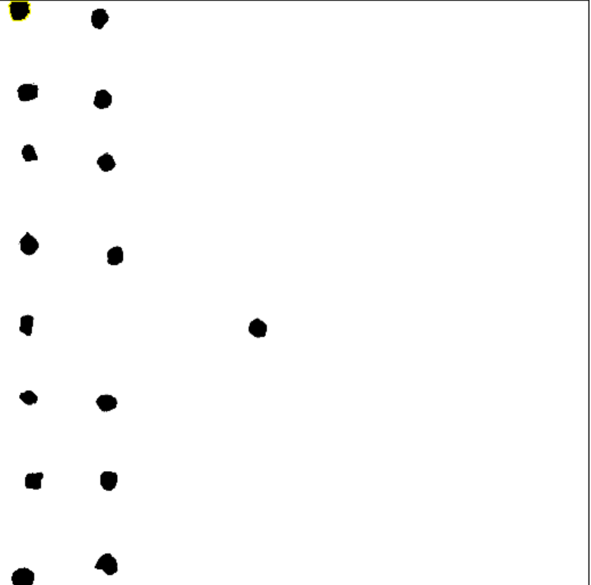
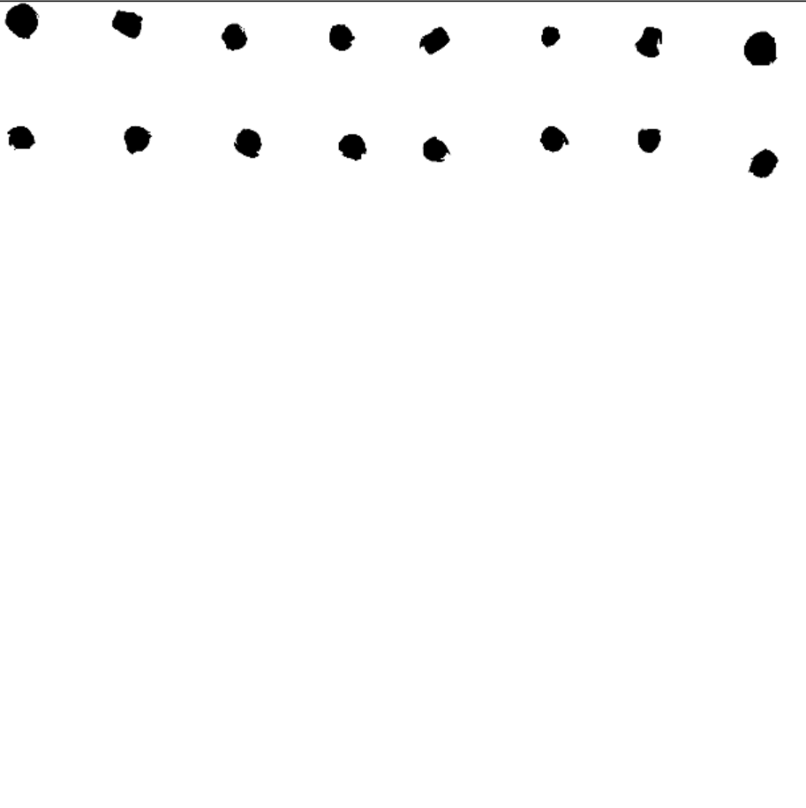
Takes Picture, Crops, and does Perspective Transform
Creates Threshold Mask of User’s Pieces
Creates Threshold Mask of CPU’s Pieces

Slide 15
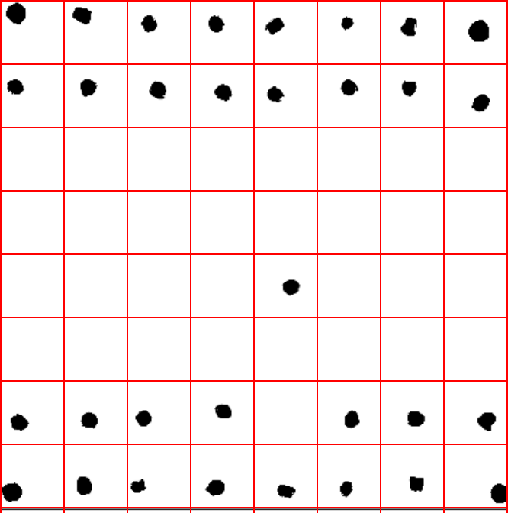
Creates 8x8 Grid Based on Current Positions After the First Move

Slide 16
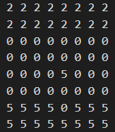
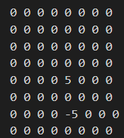
Array of Current Board State
Array of Board Deltas
Creates 8x8 Grid Based on Current Positions After the First Move

Slide 17
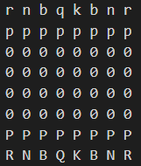
Old Chess Board Array
Deltas Array

Slide 18
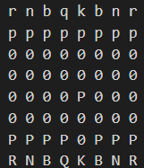
Old Chess Board Array
New Chess Board Array

Slide 22
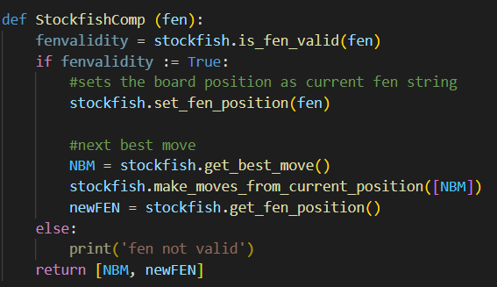
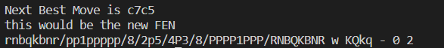

Slide 24
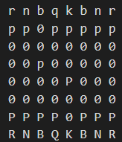

Slide 25
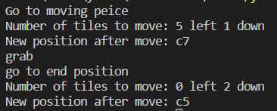

Slide 26
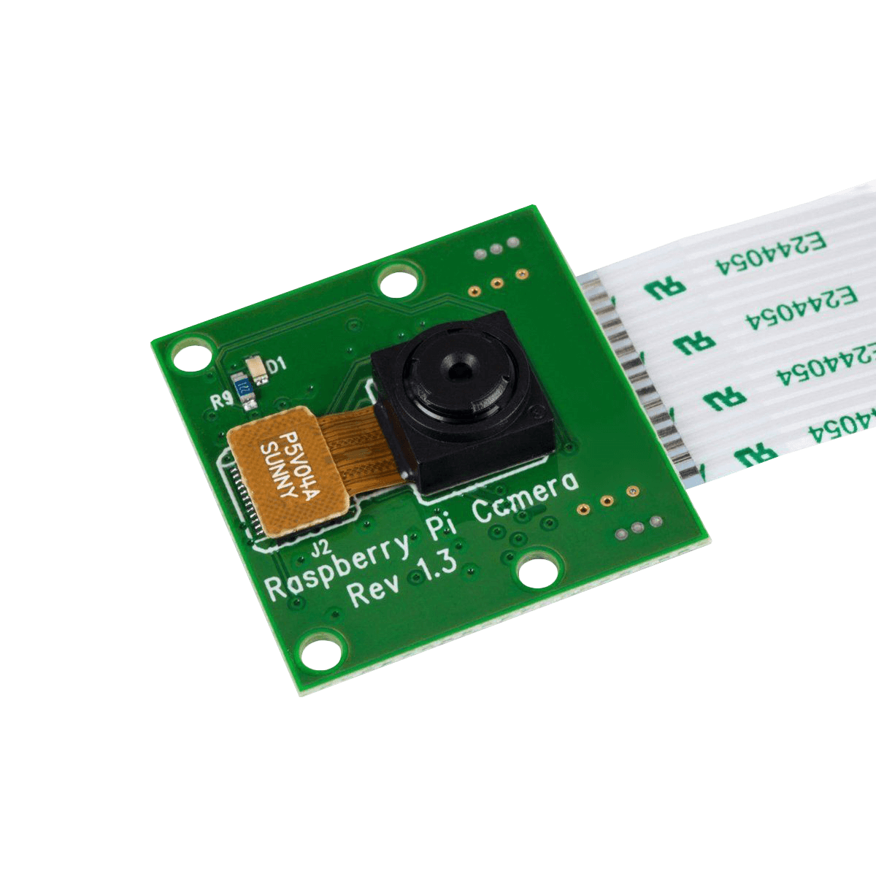


Future work
Cost Efficiency Optimization
Contact Github Developers for Insight
Built-in Camera
Notes:
Can we also add reaching out to some of the API developers on their take on digital image to chessboard to gather more insight and potentially have a resource to ask when it comes to chess board and piece recognition?

Slide 27

Thank you!
Questions?

Slide 28
Backup Slides

Slide 29
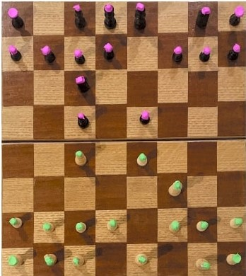
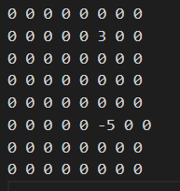
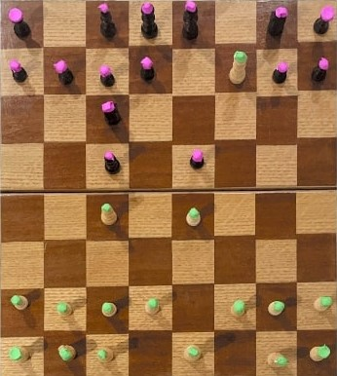
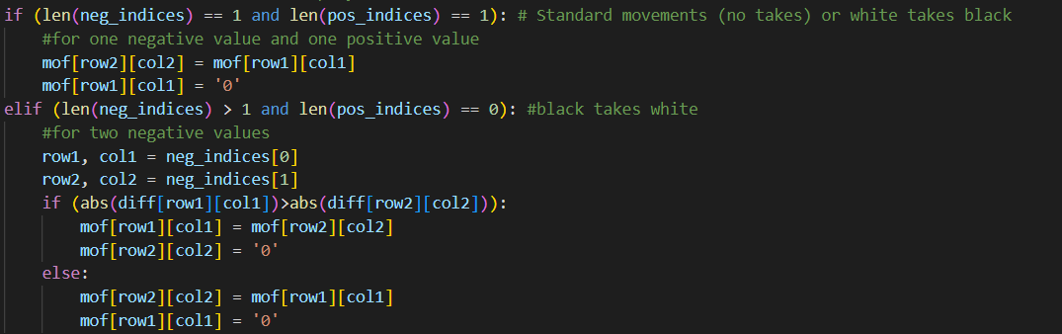
If a Piece is Captured

Slide 30
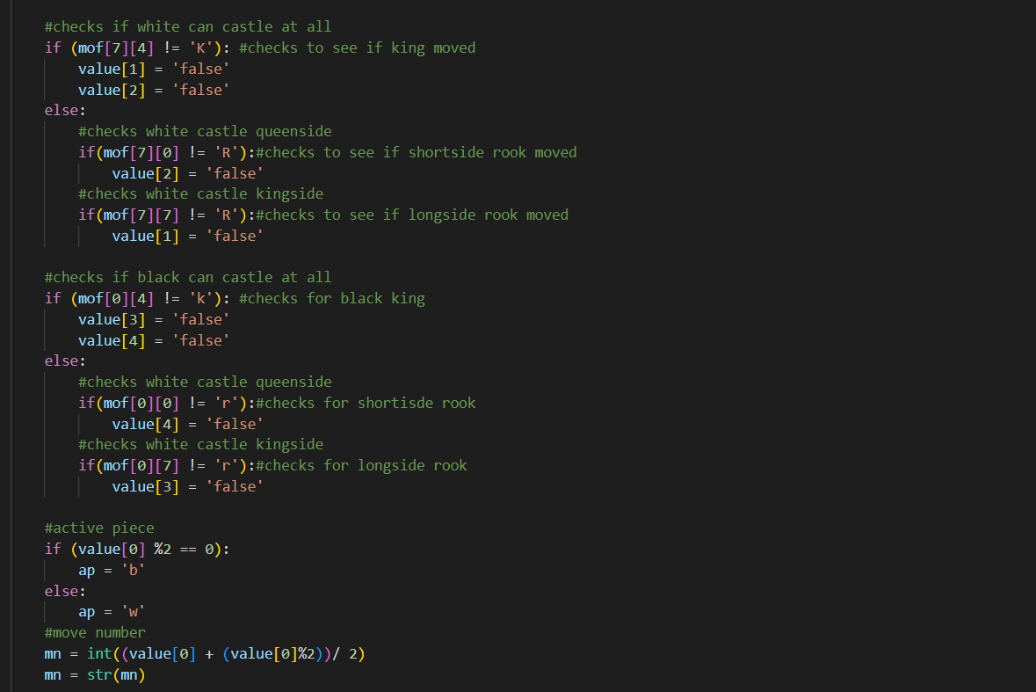
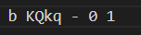
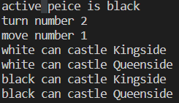
Fen Extras and Castling Rights

